Slide 1
Writing Modular JavaScript
WebDev Wednesday with Saiprasad Rakasi

Slide 2
Agenda
Build a webpage with tabs without modular js.
Figure out the issues with the code.
Try solving those issues by learning about
Object literal pattern
IIFE and closures
Module pattern
Revealing module pattern
Other useful concepts while writing modules.

Slide 3
Warning!
The code provided during this presentation is not optimal. Coded just to demonstrate the functionality.
And is no way intended to be used in your application.

Slide 4
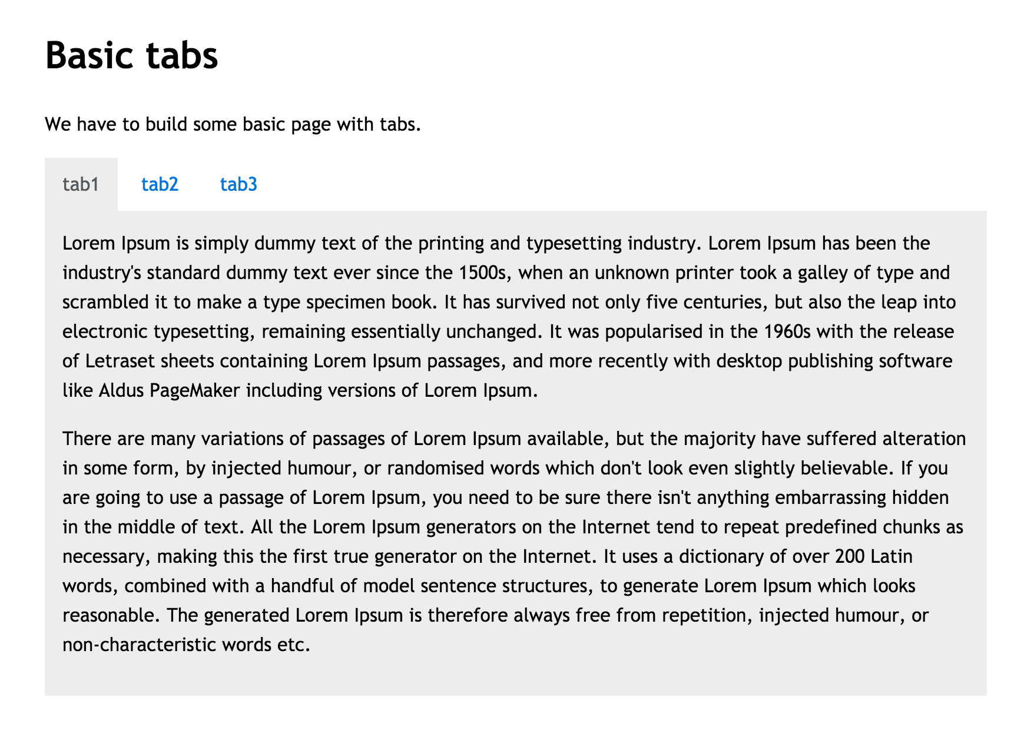
Requirement 1.0
Display tabbed content to the user.

Slide 5
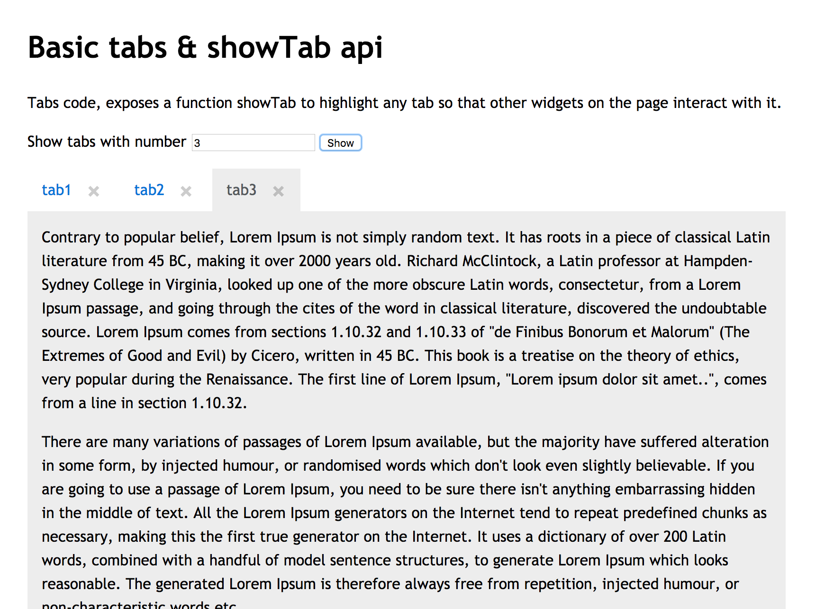
Requirement 1.1
Ability to show a particular tab from another widget. Provide option to close tabs.

Slide 6
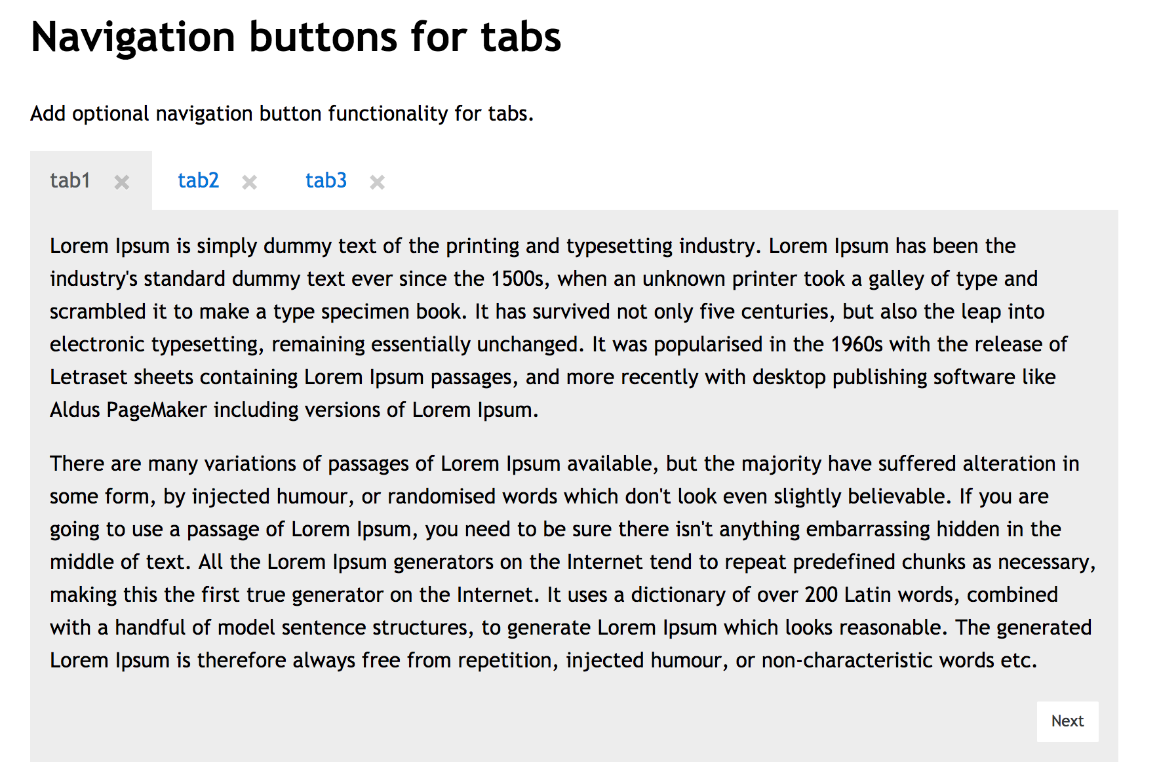
Requirement 1.2
Allow ability provide previous next buttons at the bottom of the tabs. Again make it optional.

Slide 7
Problems with code
Encapsulation:
What if there was another showTab function defined on the page.
Our state is public any one can fiddle with it.
What if someone calls private methods which we don’t intend to expose. (Ex: addCloseTab- method)
No proper interfaces defined.
Separation of concerns:
Manages more than one things – why do you need navigation in the same code base?
Add few more features, it’s a debugging night mare.
No clean separation of concerns – ex: event binding all over the place.
Difficult to unit test
Other
How do we handle changes to ‘class names’ / html structure. Selectors all over the place.
Inefficient dom selector usage.

Slide 8
Object literal pattern.
Pros:
Solves part of encapsulation esp global name space collision (not entirely but reduces the chances a lot).
Helps with separation of concerns - Code can be organized better.
Helps unit testing.
Cons:
Still provides the ability to access the private variables and methods.
Call one module method from other, is not neat. We need to always refer to module name or ‘this’.
Issues when using ‘this’ in closures.

Slide 9
Immediately Invoked function expression and closures – Brush up
What are immediately executing functions.
What are closures.
Execution context

Slide 10
Module pattern.
A combination of Object literal pattern and closures with private variables / methods in outside the Object literal.
Pros:
Solves global name space collision (not entirely but reduces the chances a lot).
Code can be organized better.
Helps unit testing.
Shields access the private variables and methods.
Cons:
Not very neat as object literal function should have to reference other functions with ‘this’ or the module name which is annoying..

Slide 11
Revealing module pattern.
Pros:
All advantages of module pattern.
There is no need to use ’this’ or module name inside functions.
Cons
Public methods though overwritten would not have effect in private methods.

Slide 12
Other concepts
Importing globals
Multiple instances of modules.
Reference
Revealing prototype pattern.
Module types– AMD, Commonjs, UMD, ES6

Slide 13
Questions?

Slide 14
Resources
Code example at
https://github.com/rsaiprasad/javascriptModulePatternPresentation
Other references
https://weblogs.asp.net/dwahlin/techniques-strategies-and-patterns-for-structuring-javascript-code

